Slide 1
Break-Even Analysis

Slide 2
Break-Even Analysis
What is break even analysis ?
A break-even analysis relates fixed cost, variable cost, and revenue to the quantity of units produced. Relationships are conveniently displayed on graphs to assist communication among decision makers.
Study of interrelationships among a firm’s sales, costs, and operating profit at various levels of output
Break-even analysis examines the cost tradeoffs associated with demand volume.
A breakeven analysis is used to determine how much sales volume your business needs to start making a profit. The breakeven analysis is especially useful when you are developing a pricing strategy, either as part of a marketing plan or a business plan.

Slide 3
Break-Even Analysis
VARIABLE COSTS (VC): variable costs change when activity changes.
Example : your telephone bill is based on how many minutes you talk.
Variable costs per unit do not change as activity increases. The cost/ minute talked is constant. For example, Rs. 1 per minute.
Materials cost, labour cost i.e, Manufacturing labour, Assembly labour, Packing labour, Shipping cost.
FIXED COSTS (FC): Fixed costs remain unchanged when activity changes. e.g., cost of equipment, Overhead labour, Utilities, Plant operation.
Total cost = Fixed costs + Variable costs

Slide 4
Break-Even Analysis
The Break-even point occurs where total revenue equals total costs – the firm, in this example would have to sell Q1 to generate sufficient revenue to cover its costs.
Total revenue is determined by the price charged and the quantity sold – again this will be determined by expected forecast sales initially.
Costs/Revenue
The total costs therefore (assuming accurate forecasts!) is the sum of FC+VC
TR
TR
TC
As output is generated, the firm will incur variable costs – these vary directly with the amount produced
The lower the price, the less steep the total revenue curve.
Initially a firm will incur fixed costs, these do not depend on output or sales.
VC
FC
Q1
TR=TC
pQ1=FC+vQ1
Q1=FC/(p-v)
Output/Sales
Q1 ?

Slide 5
Break-Even Analysis
Costs/Revenue
TC
If the firm chose to set price higher than Rs. 20 (say Rs.30) the TR curve would be steeper – they would not have to sell as many units to break even
TR (p = Rs.30)
TR (p = Rs. 20)
VC
FC
Q2
Q1
Output/Sales

Slide 6
Break-Even Analysis
TR (p = Rs. 10)
Costs/Revenue
If the firm chose to set prices lower (say Rs.10) it would need to sell more units before covering its costs
TR (p = Rs. 20)
TC
VC
FC
Q1
Q3
Output/Sales

Slide 7
Break-Even Analysis
Costs/Revenue
TR (p = Rs. 20)
TC
Profit
VC
Loss
FC
Q1
Output/Sales

Slide 8
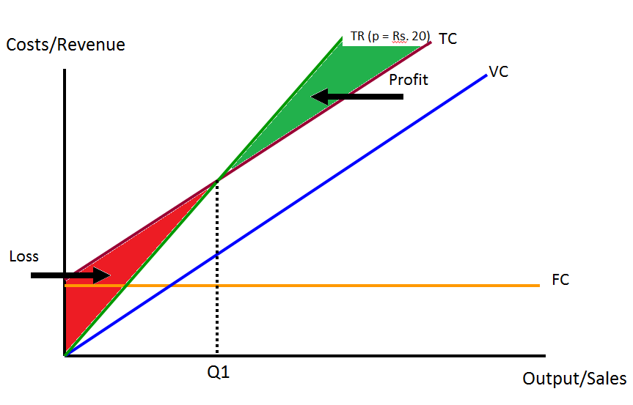
Break-Even Analysis

Slide 9
Break-Even Analysis
TR (p = Rs. 30)
TR (p = Rs. 20)
TC
A higher price would lower the break even point and the margin of safety would widen
Costs/Revenue
Margin of safety shows how far sales can fall before losses made. If Q1 = 1000 and Q2 = 1800, sales could fall by 800 units before a loss would be made
VC
Assume current sales at Q2
Margin of Safety
FC
Q3
Q1
Q2
Output/Sales

Slide 10
Break-Even Analysis
Example 1: Make or buy decision
Purchase price = Rs. 200 per piece
Manufacturing costs
FC=Rs. 5,00,000
VC=150 per piece
TC_{buy}
TC_{make}
BEQ=FC/(p-v) =5,00,000/(200-150)
=10,000
Cost
Q=10,000

Slide 11


Break-Even Analysis
Example 2: Comparing two production methods
Bowsaw or chainsaw to cut trees
Bowsaw
Fixed cost is $5.00
Variable cost is $0.40 per
Chainsaw
Fixed cost is $305
Variable cost is $0.10 per tree
Solution
Q_{(break-even)} = (305 - 5)/(0.40 - 0.10)
= 300/0.30 = 1,000 trees
TC_{Bowsaw}
Cost
TC_{Chainsaw}
Q

Slide 12
Nonlinear Breakeven Analysis
Assumptions: (1) Price varies with demand; (2) We have fixed costs; (3) We have constant variable cost.
$
Maximum
Profit
TC= FC + vQ
TR= pQ
Break-even
Point
Break-even
Point
Fixed Cost: FC

